Slide 1
An Innovative Procedure for Improving Differential Diagnosis and Validity of the Neuropsychological Assessment
Neuropsychological Assessment of Distractibility
in mild Traumatic Brain Injury and Depression
Schnabel, R., & Kydd, R. (2012). Neuropsychological Assessment of Distractibility in Brain Injury The Clinical Neuropsychologist, 2012, 1–21, ISSN: 1385-4046 print/1744-4144 online

Slide 2
Standard Neuropsychological Assessment
Neuropsychological assessments are to be conducted in a controlled, distraction-free environment (Lezak, et al., 2004; Spreen & Strauss, 1998).
“To provide an ideal environment, administer the test in a quiet room that is free from distraction and interruptions. External distractions must be minimised to focus the examinee’s attention on the task presented and not on outside sounds or sights.“ (Wechsler, 2008, p. 24)

Slide 3
Distractibility has remained un-assessed
A prominent feature of acquired brain damage, specifically with frontal lobe impact, is clients’ inability to manage distractions imposed by complex, busy environments.
Damage to the frontal lobes of the brain was demonstrated to correlate with deficits in working memory and problems with attention-control/distractibility (Brewer, 1998; Brewer, Metzger, & Therrien, 2002; Couillet J, 2010; Knight, Titov, & Crawford, 2006; Krawczyk et al., 2008; Lutz, 1999; Trudel, Tryon, & Purdum, 1998).
The formal evaluation of clients’ capacity for managing environmental distractions has not been part of the clinical neuropsychological assessment.

Slide 4
Objectives
The current study had two main objectives.
1. Develop a short, replicable, additional test condition that includes standardised auditory/visual distraction-stimuli.
2. Examine the effect of this test condition on performance for different client groups: mTBI, Major Depressive Episode (MDE), and healthy controls.

Slide 5
Distraction stimuli
The distraction was provided by playing 2 specific computerised audio-visual recordings showing a woman reading a news story (“File 1”) & random numbers (“File 2”).
Played on a laptop computer (screen ø 16.5”); sound level of 55 DB
Positioned like a third person in an equilateral triangle, approximately 1 m from both client and examiner.

Slide 6
Design
Clients take a re-test of selected WAIS IV /WMS IV tasks (LM-I, DSF, DST,LNS) while exposed to distraction
→ Distraction File 1 (story) is played in the background while client undertakes WMS-LM test
Distraction file 2 (random numbers) is played in the background while client undertakes DSF, DST, LNS
Results obtained in the distraction condition are compared to:
→ Results achieved by this client achieved in the standard condition
→ Norms for the client’s age group.
Clients rate the degree of stress experienced in the distraction condition.

Slide 7
Participants (n=240)
80 mTBI | 80 MDE | 80 Control
Standard diagnostic criteria (Carroll et al., 2004; Ruff et al., 2009) 54 to 129 days post- injury Clients with poor test effort excluded (Tombaugh, 2003) Middle to upper end of severity (1/3 with complications) | DSM-IV TR criteria (American Psychiatric Ass., 2000) 47.5% relapse of MDD No bipolar disorder, psychosis, or personality disorder No history of acquired brain injury | Absence of mental health disorders Absence of acquired brain injuries, other than trivial concussions

Slide 8
Results
 | Study Group
 | MDE | mTBI | Control
Age (mean ± SD) | 44.7 ± 9.3* | 38.6 ± 12.2 | 41.5 ± 13.9
Age (min/max) | 23-60 | 18-64 | 16-69
Gender (n, %) Female Male | 48 (60.0)** 32 (40.0) | 31 (38.8) 49 (61.3)** | 40 (50.0) 40 (50.0)

Slide 9
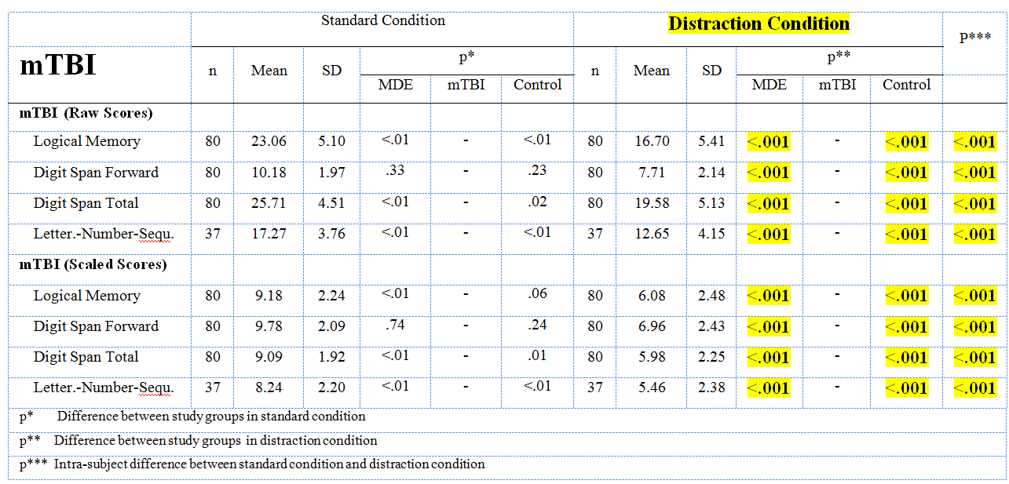
Test Scores Derived from Standard and Distraction Setting by Study Group
(mTBI)

Slide 10
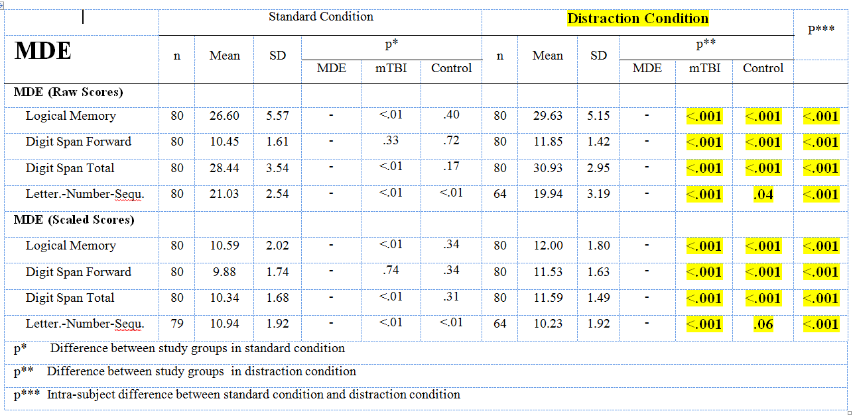
Test Scores Derived from Standard and Distraction Setting by Study Group
(MDE)

Slide 11
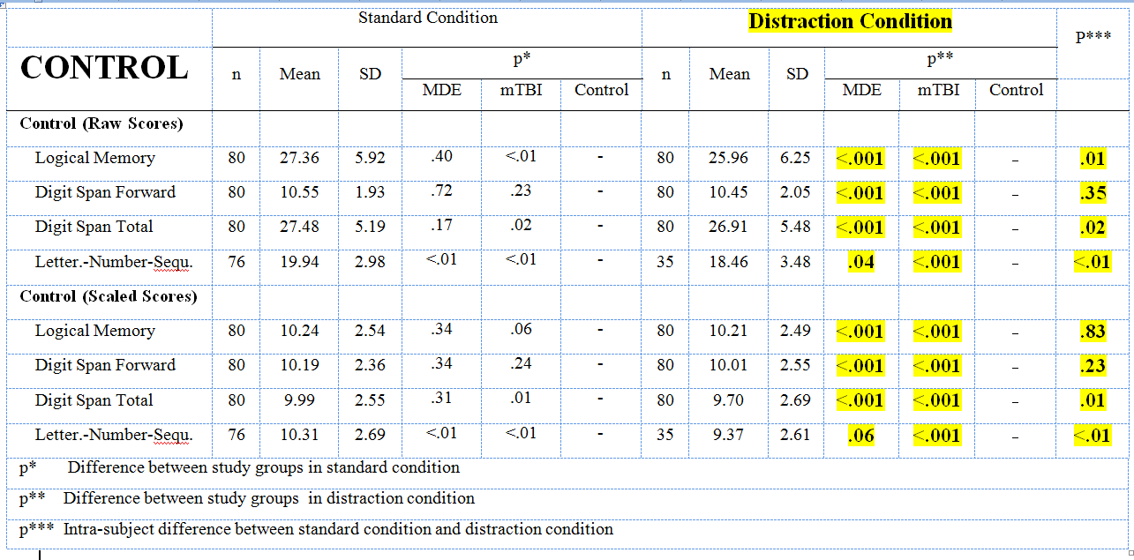
Test Scores Derived from Standard and Distraction Setting by Study Group
(Control Group)

Slide 12
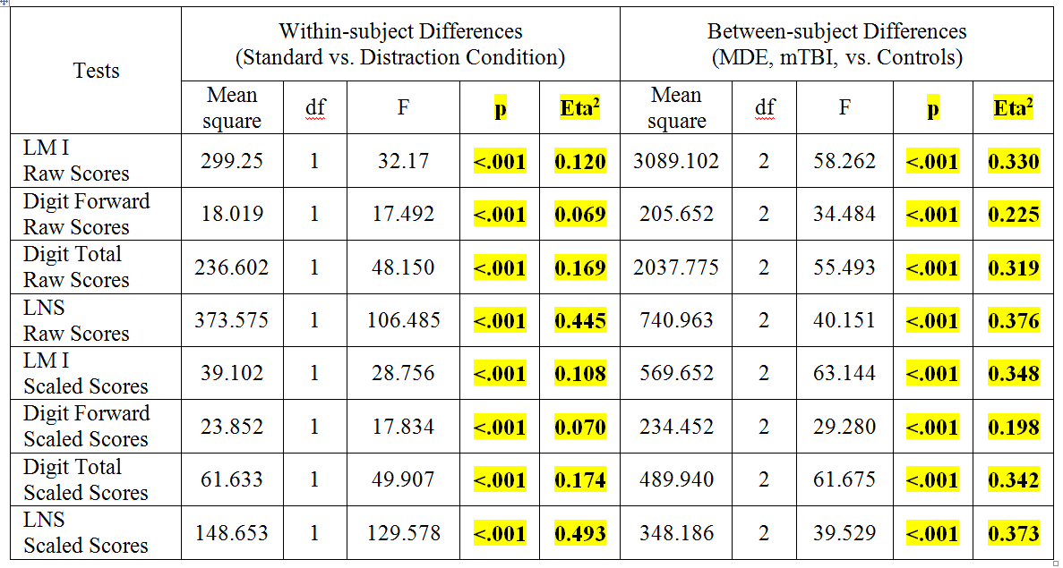
Mixed Model ANOVA analysis
Of Within-Subject and Between Subject Differences on test performance

Slide 13
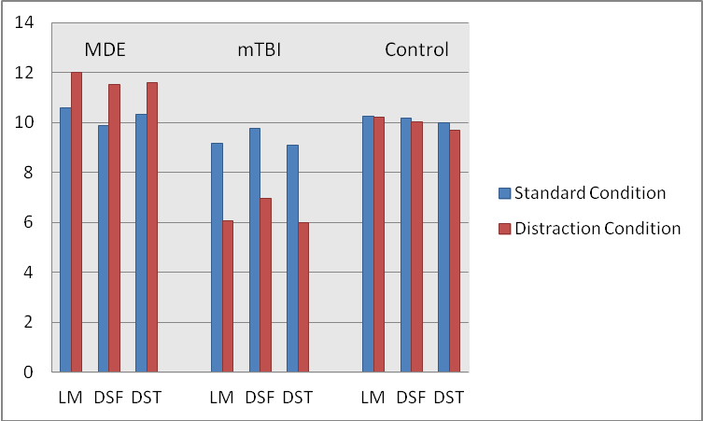
Change of Performance in Standard vs. Distraction Condition (n=240)

Slide 14
Differences in Stress-Levels under Distraction Condition for Different Groups

Slide 15
So, is “Distraction Testing” a good idea?
Exposing clients’ problems with environmental distractions
Improving ecological validity of the Neuropsychological Assessment
Watershed test for differential diagnosis (Organic vs. Psychological disorder), as different client populations respond quite differently & distinctively to exposure to environmental distraction.

Slide 16
References
Brewer, T. L., Metzger, B., & Therrien, B. (2002). Trajectories of cognitive recovery following a minor brain injury. Research in Nursing & Health, 25(4), 269-281.
Bush, S. S., Ruff, R. M., Tröster, A. I., Barth, J. T., Koffler, S. P., Pliskin, N. H., et al. (2005). Symptom validity assessment: practice issues and medical necessity NAN policy & planning committee. Arch Clin Neuropsychol, 20(4), 419-426.
Chan, R. C. K. (2001). Base rate of post-concussion symptoms among normal people and its neuropsychological correlates. Clinical Rehabilitation, 15, 266-273.
Couillet J, S. S., Lebornec G, Asloun S, Joseph PA, Mazaux JM, Azouvi P. (2010). Rehabilitation of divided attention after severe traumatic brain injury: a randomised trial. Neuropsychol Rehabil, 20(3), 321-339.
Garden, N., & Sullivan, K. A. (2010). An examination of the base rates of post-concussion symptoms: The influence of demographics and depression. Applied Neuropsychology, 17(1), 1-7.
Green, P., Rohling, M., Lees-Haley, P. R., & Lyle, M. A. (2001). Effort has a greater effect on test scores than severe brain injury in compensation claimants. Brain Injury, 15(12), 1045-1060.
Iverson, G., & McCracken, L. (1997). 'Post-concussive' symptoms in persons with chronic pain. Brain Injury, 11, 783-790.
Iverson, G. L. (2006). Misdiagnosis of the persistent post-concussion syndrome in patients with depression. Archives of Clinical Neuropsychology, 21, 303-310.
Iverson, G. L., & Lange, R. T. (2003). Examination of "Postconcussion-Like" Symptoms in a Healthy Sample. Applied Neuropsychology, 10(3), 137-144.

Slide 17
Knight, R. G., Titov, N., & Crawford, M. (2006). The effects of distraction on prospective remembering following traumatic brain injury assessed in a simulated naturalistic environment. Journal of the International Neuropsychological Society, 12(1), 8-16.
Krawczyk, D. C., Morrison, R. G., Viskontas, I., Holyoak, K. J., Chow, T. W., Mendez, M. F., et al. (2008). Distraction during relational reasoning: the role of prefrontal cortex in interference control. Neuropsychologia, 46, 2020–2032.
Lezak, M., Howieson, D. B., & Loring, D. W. (2004). Neuropsychological Assessment (4th ed.). New York: Oxford University Press.
Lutz, R. L. (1999). Assessment of attention in adults following traumatic brain injury. Vocational Evaluation & Work Adjustment Journal, 32(1), 47-53.
Schnabel, R. (2012). Overcoming the Challenge of Re-assessing Logical Memory. The Clinical Neuropsychologist, 26(1), 102-115.
Schnabel, R., & Kydd, R. (2012). Neuropsychological Assessment of Distractibility in Brain Injury The Clinical Neuropsychologist, in print, available in June 2012.
Sollman, M. J., & Berry, D. T. R. (2011). Detection of Inadequate Effort on Neuropsychological Testing: A Meta-Analytic Update and Extension. Archives of Clinical Neuropsychology, 26(8), 774-789. doi: 10.1093/arclin/acr066
Spreen, O., & Strauss, E. (1998). A compendium of neuropsychological tests (2nd ed.). New York: Oxford University Press.
Trudel, T. M., Tryon, W. W., & Purdum, C. M. (1998). Awareness of disability and long-term outcome after traumatic brain injury. Rehabilitation Psychology, 43(4), 267-281.
Wang, Y., Chan, R. C. K., & Deng, Y. (2006). Examination of post-concussion-like symptoms in healthy university students: Relationships to subjective and objective neuropsychological function performance. Archives of Clinical Neuropsychology, 21, 339-347.
Wechsler, D. (2008). Wechsler Adult Intelligence Scale - Fourth Edition - Technical and Interpretive Manual. San Antonio, Texas: Pearson.

Slide 18
